Slide 1
Introduction to John’s Gospel
“These [things] are written that you may believe that Jesus is the Messiah, the Son of God, and that by believing you may have life in his name.”

Slide 2
Introduction to John’s Gospel
Purpose!
Jesus performed many other signs in the presence of his disciples, which are not recorded in this book. But these are written that you may believe that Jesus is the Messiah, the Son of God, and that by believing you may have life in his name. John 20:30-31

Slide 3
Introduction to John’s Gospel
Purpose!
Secretive?

Slide 4
Introduction to John’s Gospel
Purpose!
Secretive?
Lazarus, Mark or Thomas?

Slide 5
Introduction to John’s Gospel
Purpose!
Secretive?
Lazarus, Mark or Thomas?
John

Slide 6
Introduction to John’s Gospel
Purpose!
Secretive?
Lazarus, Mark or Thomas?
John
Why the mystery?

Slide 7
Introduction to John’s Gospel
Purpose!
Secretive?
Structured

Slide 8
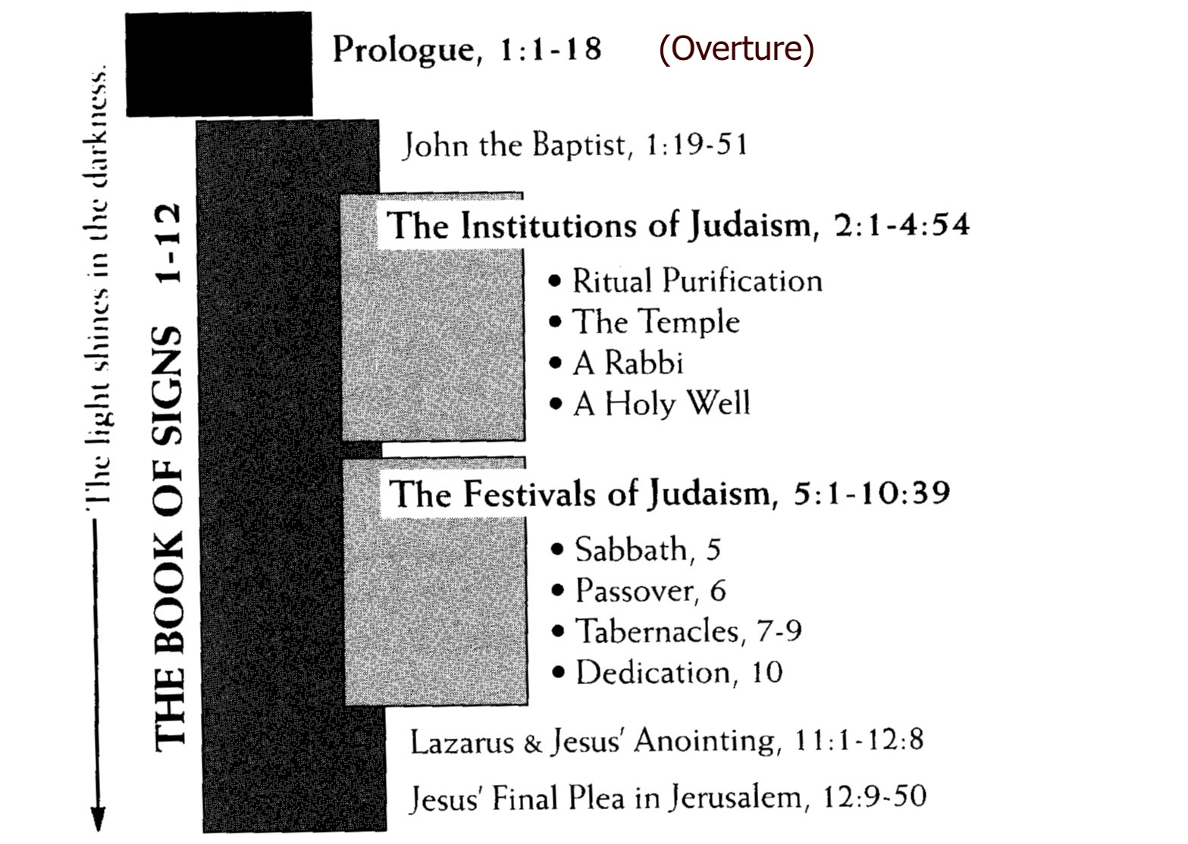
Introduction to John’s Gospel
Purpose!
Secretive?
Structured

Slide 9
Introduction to John’s Gospel
Purpose!
Secretive?
Structured
Selective
No account of nativity
No mention of baptism/temptations
No list of disciples
No casting out of demons
No Lord’s Supper
No agonising in Gethsemane

Slide 10
Introduction to John’s Gospel
Purpose!
Secretive?
Structured
Selective
Symbolic

Slide 11
Introduction to John’s Gospel
Purpose!
Secretive?
Structured
Selective
Symbolic
Language

Slide 12
Introduction to John’s Gospel
Purpose!
Secretive?
Structured
Selective
Symbolic
Language
Comparisons

Slide 13
Introduction to John’s Gospel
Purpose!
Secretive?
Structured
Selective
Symbolic
Language
Comparisons
Signs

Slide 14
Introduction to John’s Gospel
Purpose!
Secretive?
Structured
Selective
Symbolic
Language
Comparisons
Signs
Key words – “I am”

Slide 15
Introduction to John’s Gospel
Purpose!
Secretive?
Structured
Selective
Symbolic
Language
Comparisons
Signs
Key words – “I am”, “life”

Slide 16
Introduction to John’s Gospel
Purpose!
Secretive?
Structured
Selective
Symbolic
Language
Comparisons
Signs
Key words – “I am”, “life”, “darkness/light”

Slide 17
Introduction to John’s Gospel
Purpose!
Secretive?
Structured
Selective
Symbolic
Language
Comparisons
Signs
Key words – “I am”, “life”, “darkness/light”, “world”

Slide 18
Introduction to John’s Gospel
Purpose!
Secretive?
Structured
Selective
Symbolic
Language
Comparisons
Signs
Key words – “I am”, “life”, “darkness/light”, “world”, “hour”

Slide 19
Introduction to John’s Gospel
Purpose!
Secretive?
Structured
Selective
Symbolic
Specific purpose!
That you may believe…

Slide 20
Introduction to John’s Gospel
Purpose!
Secretive?
Structured
Selective
Symbolic
Specific purpose!
Reaction?

